Slide 1

CMR COLLEGE OF ENGINEERING & TECHNOLOGY
Kandlakoya, Medchal, Hyderabad - 501401
Department of Computer Science and Engineering
SORTING ALGO TRACKER
Team Members
20H51A0557 A Bhagya Sree
20H51A0566 I.Anvita
20H51A0568 M. Priyanka
Under esteemed guidance of
P.SRAVANTI

Slide 2
ABSTRACT
Learning about sorting algorithms has become a tough task, for a student they often failed to understand the core idea of a particular algorithm maybe because they are unable to visualize how they work.
This web application makes everyone to understand how algorithms works through visualizations.
This project is built by using HTML,CSS,JAVASCRIPT.
This sorting algos is a very simple UI which allows user to select the sort algorithm, select the array size and the speed of visualization.

Slide 3
introduction
We have learnt sorting algorithms like bubble sort, selection sort, insertion sort, quick sort manually.
This consumes a lot of time to analyse the iterations.
Hence to understand it better we need to visualize them.
Sorting algo tracker is a web app for visualizing a bunch of different sorting algorithms Like Selection Sort, Bubble Sort, Insertion Sort, Merge Sort, Quick Sort, Heap Sort.
Using the functionality of (Speed Control) and (Array Size Control).

Slide 4
Literature survey
Existing system
Manual method :
- Students often learn about algorithms by attending classes and through textbooks.
- Using references of Wikipedia and videos students could learn about this

Slide 5
PROBLEMS IN EXISTING SYSTEM
Unable to trace the algorithms because it consumes lot of time
Students tend to lose intrest and patience while working on large set of inputs.
Through manual methods students face issue in visualization and this leads to low efficiency.

Slide 6
ReSEARCH OBJECTIVE
Our objective is to develop a website which visually shows how sorting algos work.
To control the speed of them to understand better
To improve efficiency

Slide 7
PROBLEM DEFINITION
A very simple UI which allows user to select the sort algorithm, select the array size and the speed of visualization and a quiz.

Slide 8
PROPOSED METHODS
We created using hypertext markup language
Made design using cascading style sheets
Javascript code for backend development
Our project is based on sorting algorithms which shows visual working of how each iteration of sorting is done.
The users can also control the speed of the working, size.
It also displays time complexities of each algorithm once done.
We have also added a quiz page where the users can test their knowledge.

Slide 9
RESEARCH WORK
PROPOSED SYSTEM ARCHITECTURE:
SORTING ALGO’S
HOME
SORT
QUIZ
BUBBLE
SUBMIT
QUITT
SELECTION
INSERTION
QUICK
HEAP
MERGE

Slide 10
PERFORMANCE MEASURE
EFFICIENT
FAST
EASILY UNDERSTOOD
SPEED CONTROL
ARRAY SIZE CONTROL

Slide 11
RESULT ANALYSIS
The website is working fine for all the sorting algorithms included.
With the addition of speed and size controls, the user is able to understand it more easily
By clicking on quiz multiple choice questions are displayed so that user could select one of the options.
After the test result is displayed in the form of percentage, you can also quit the quiz if you wish to.

Slide 12
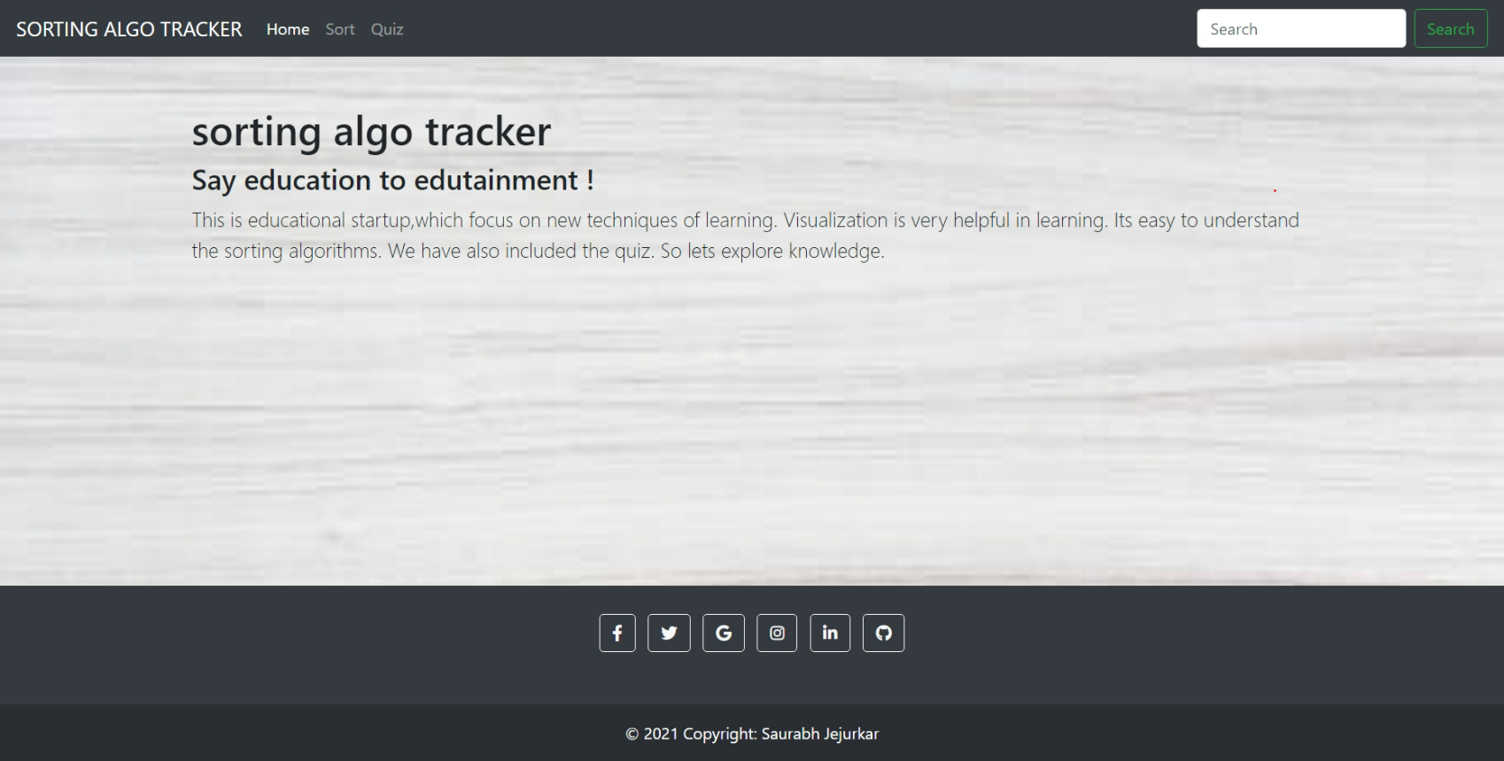

Slide 13
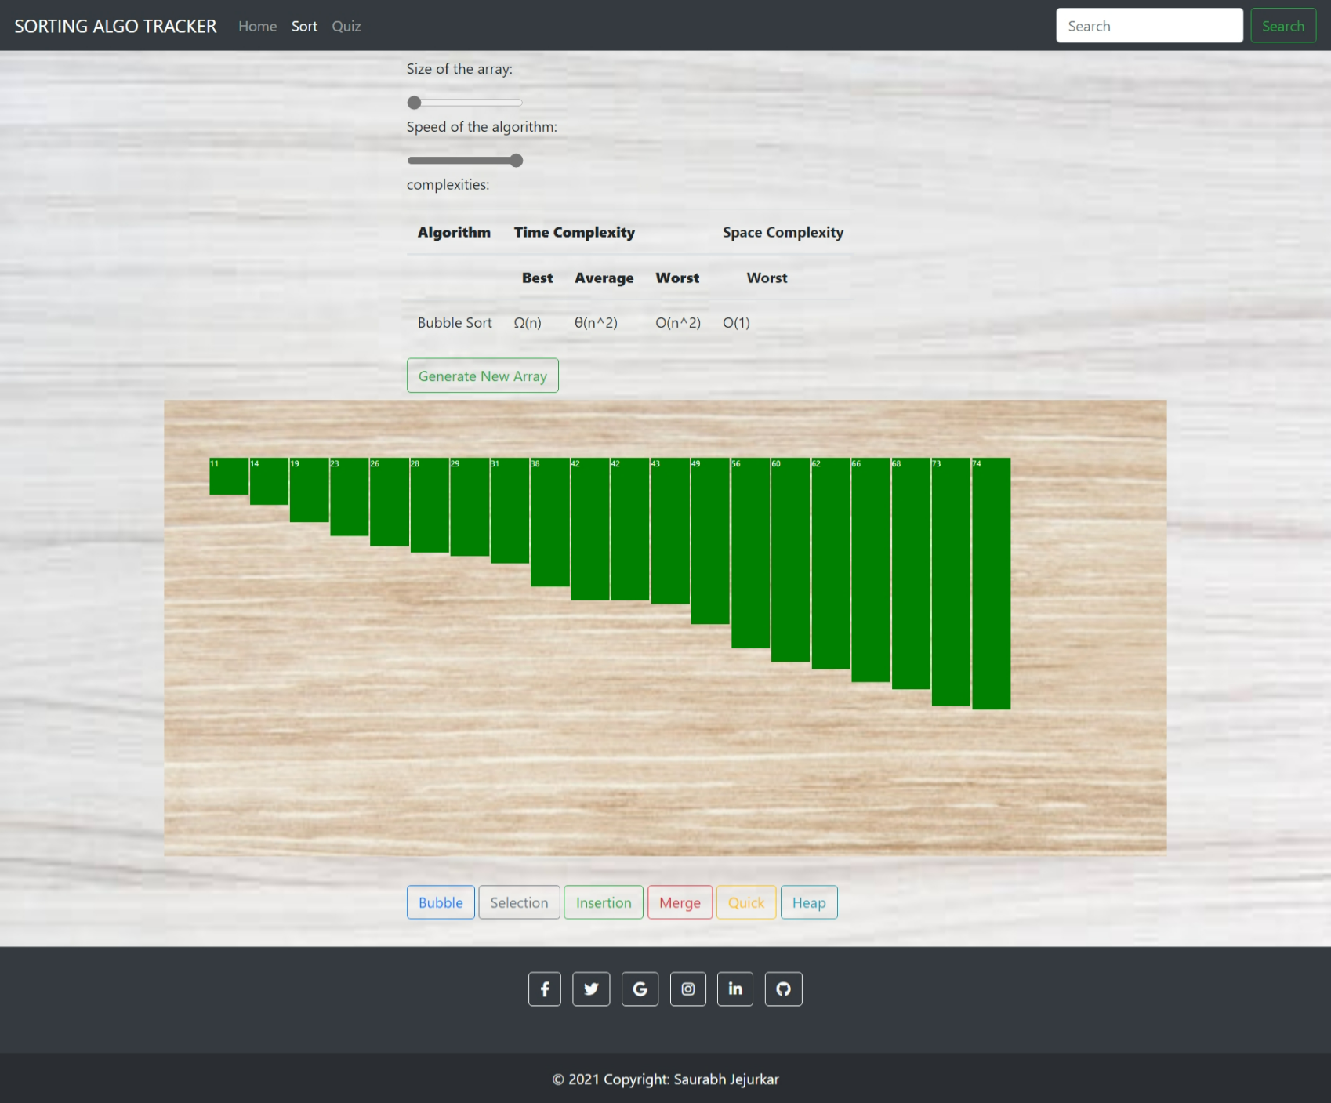

Slide 14
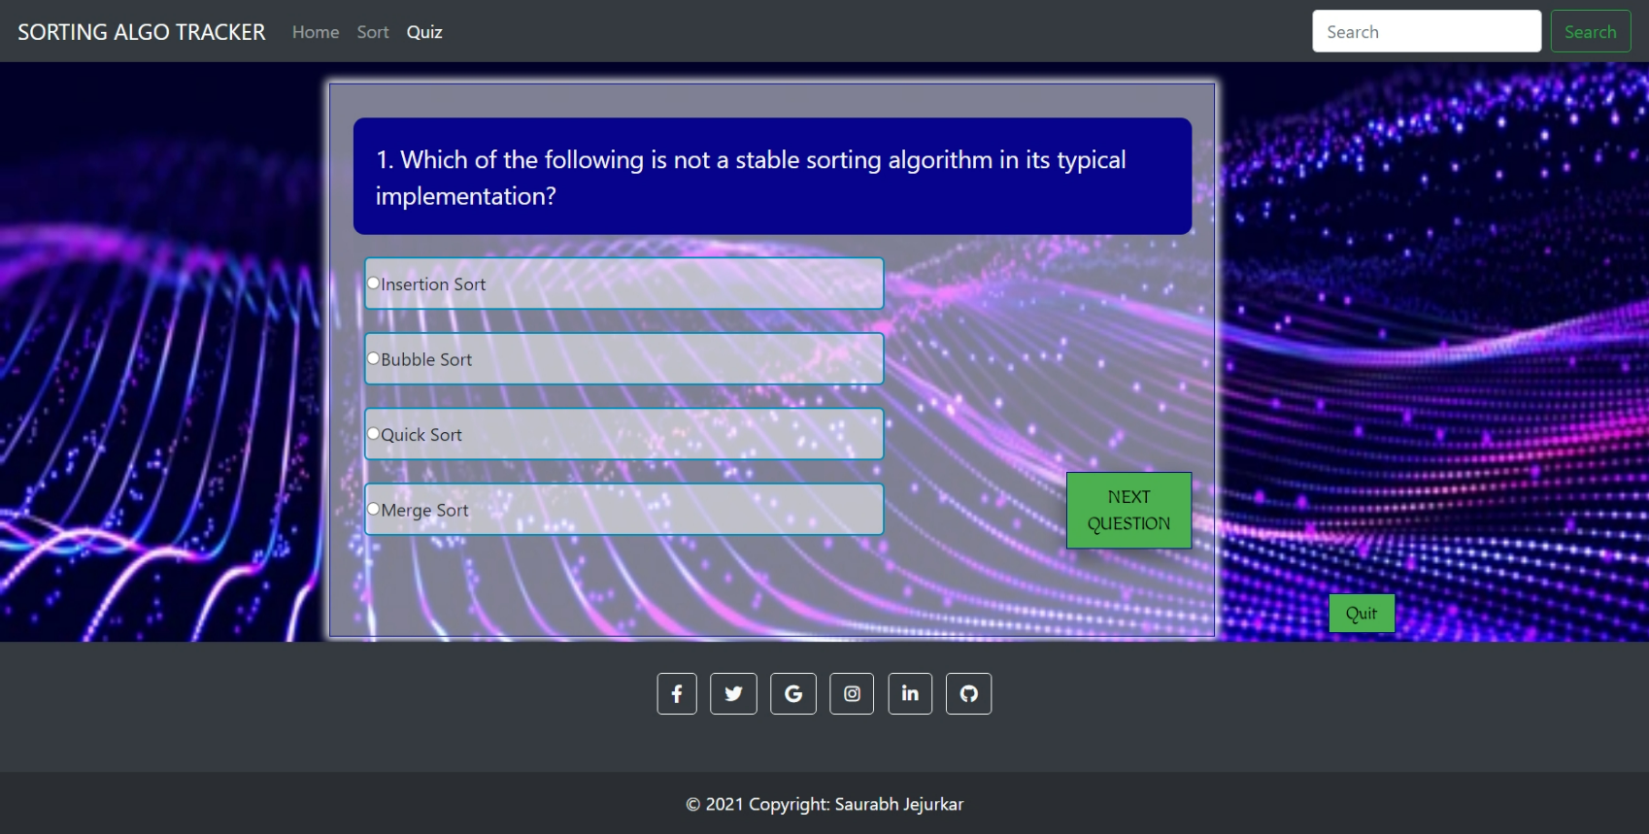

Slide 15
FUTURE WORK
Including pause and restart buttons.
Adding control panel
Helpful for beginers
easy to understand
Search engine optimization

Slide 16
rEFERENCES
https://www.geeksforgeeks.org/sorting-algorithms/
https://www.programiz.com/dsa/sorting-algorithm
https://www.javatpoint.com/time-complexity-of-sorting-algorithms
https://www.w3schools.com/

Slide 17

THANK YOU

